Slide 1

Innovating Crop Protection: A Smart Solution
Protecting crops from wild animals is a critical challenge for farmers globally. Our innovative project offers a sustainable, cost-effective, and safe solution to minimise crop damage and enhance farm safety.
By:
Mokshitha KJ
Paresh R

Slide 2
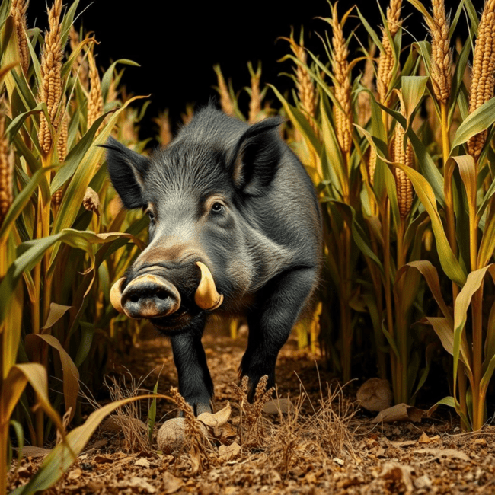
The Challenge: Human-Wildlife Conflict
Farmers, especially those near forest or wildlife habitats, face significant crop damage from animals like wild boars, elephants, and deer. This leads to substantial financial losses and dangerous human-animal confrontations.

Slide 3




Limitations of Traditional Methods
Costly Fencing
Building and maintaining robust physical fences is often prohibitively expensive for most farmers, requiring significant upfront investment and ongoing upkeep.
Unreliable Guarding
Human guarding is labour-intensive, prone to fatigue, and offers limited effectiveness, especially during night hours or in adverse weather conditions.
Unsafe Interactions
Direct human intervention to deter animals can be extremely dangerous, risking injury or even loss of life for farmers and farmhands.

Slide 4
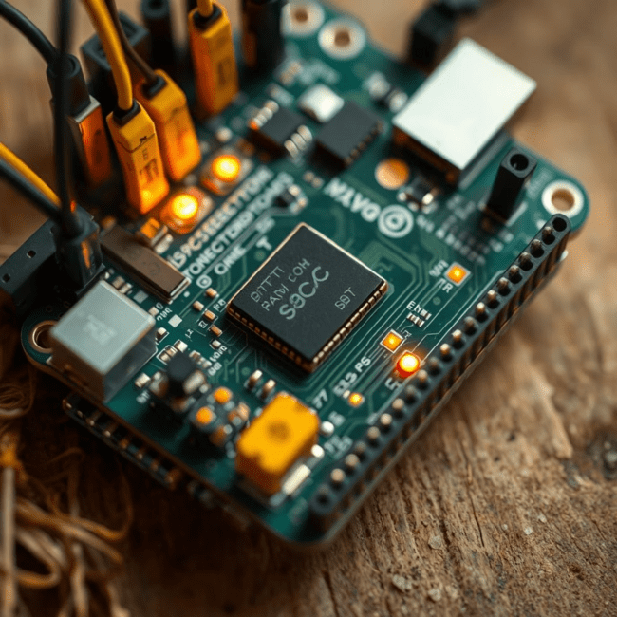
Our Solution: A Smart, Automated System
We present a low-cost, automated, and intelligent system designed to protect crops. Utilizing an Arduino board as its central controller, our solution integrates seamlessly with various sensors for real-time detection and alerts.

Slide 5

Core Components of the System
Arduino Microcontroller
The brain of the system, processing sensor data and triggering responses. Its versatility allows for customisable programming to adapt to different farm environments.
Motion Sensors
Detects the presence and movement of animals within designated farm zones, initiating the alert sequence. These are crucial for early detection.
Laser Sensors
Forms an invisible perimeter, triggering an alert when an animal breaks the laser beam, offering precise detection even in challenging conditions.
Fire Sensors
An added safety feature to detect fire hazards on the field, providing immediate alerts to prevent widespread damage and ensure farm safety.

Slide 6




How the System Works: Real-Time Detection
Animal Intrusion
Wild animals cross either the motion or laser detection zones on the farmland.
Sensor Activation
The sensors detect the intrusion and instantly send signals to the connected Arduino board.
Alert Trigger
The Arduino processes the signals and triggers an immediate alert system to inform the farmer and deter the animal.

Slide 7
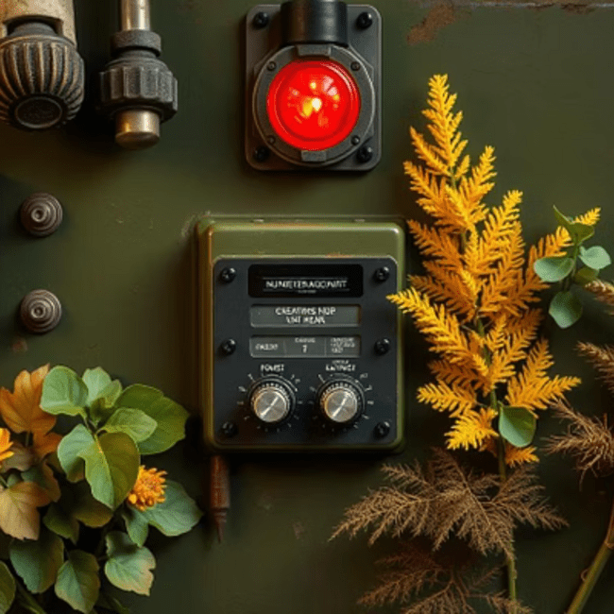

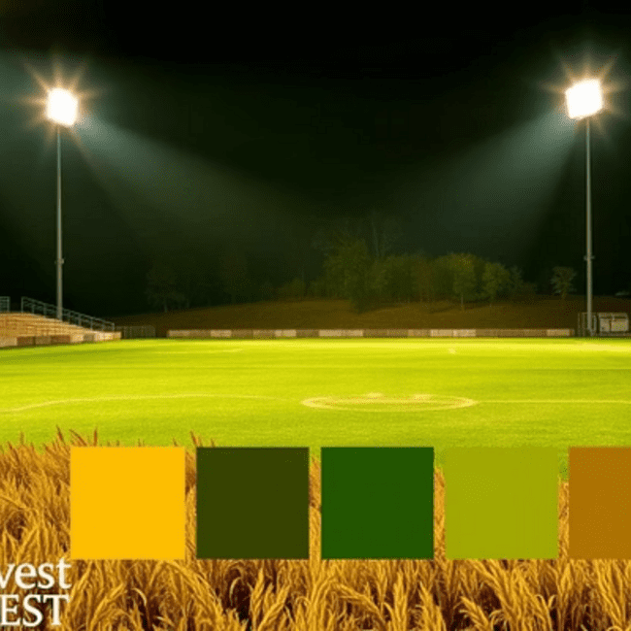
Diverse Alert Mechanisms
Upon detection, the system can activate various alerts: a loud buzzer to scare animals, mobile notifications for farmers' immediate awareness, or powerful lights to deter intruders and illuminate the area.

Slide 8

Benefits: Enhanced Farm Safety and Productivity
90%
10x
80%
Crop Damage Reduction
Increased Farm Safety
Reduced Human Intervention
Minimises destruction, ensuring higher yields and greater financial stability for farmers.
Reduces dangerous human-animal conflicts and provides early fire hazard warnings.
The automated system frees up farmers' time, allowing them to focus on other critical farming tasks.

Slide 9

Conclusion and Future Scope
Our smart crop protection system offers a robust, cost-effective solution for a pervasive agricultural problem. Future enhancements include AI-driven animal identification, solar power integration, and expanded sensor networks for even greater coverage and efficiency.

